Slide 1
Lecture 2

Slide 2
(Design) Research
History & Pioneers

Slide 3
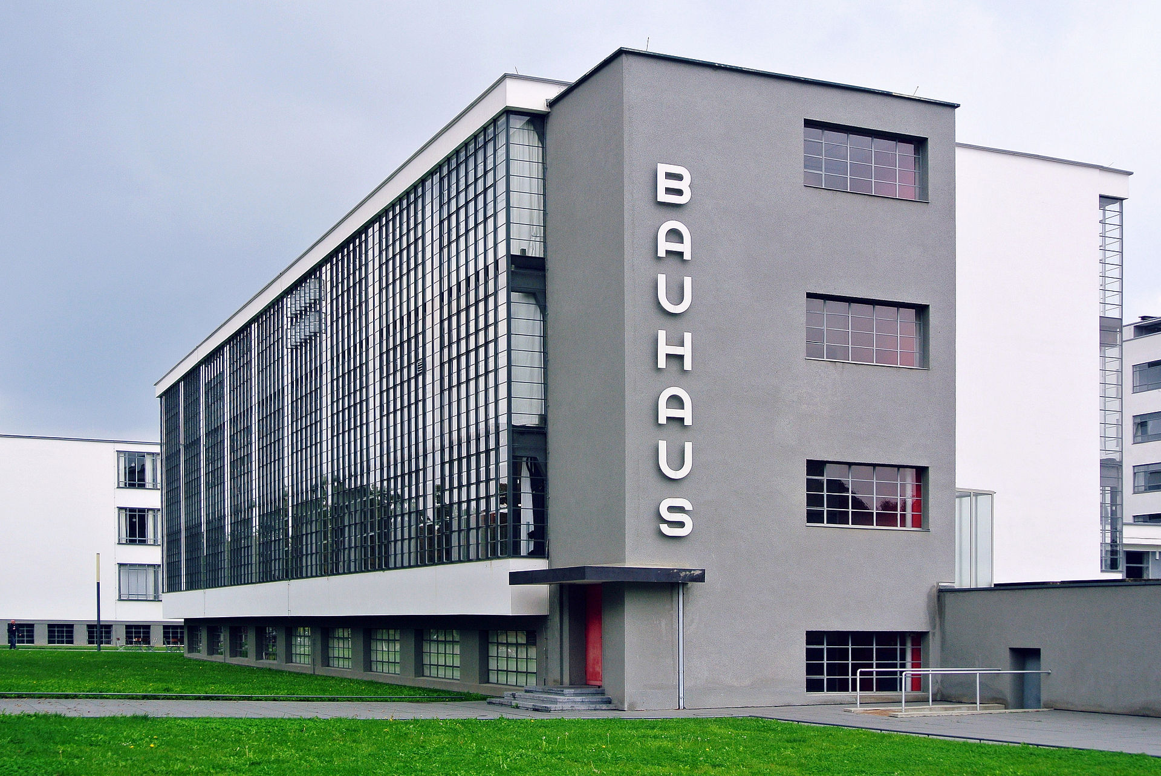
BAUHAUS
A German art school operational from 1919 to 1933 that combined crafts and the fine arts. The school became famous for its approach to design, which attempted to unify individual artistic vision with the principles of mass production and emphasis on function.

Slide 4
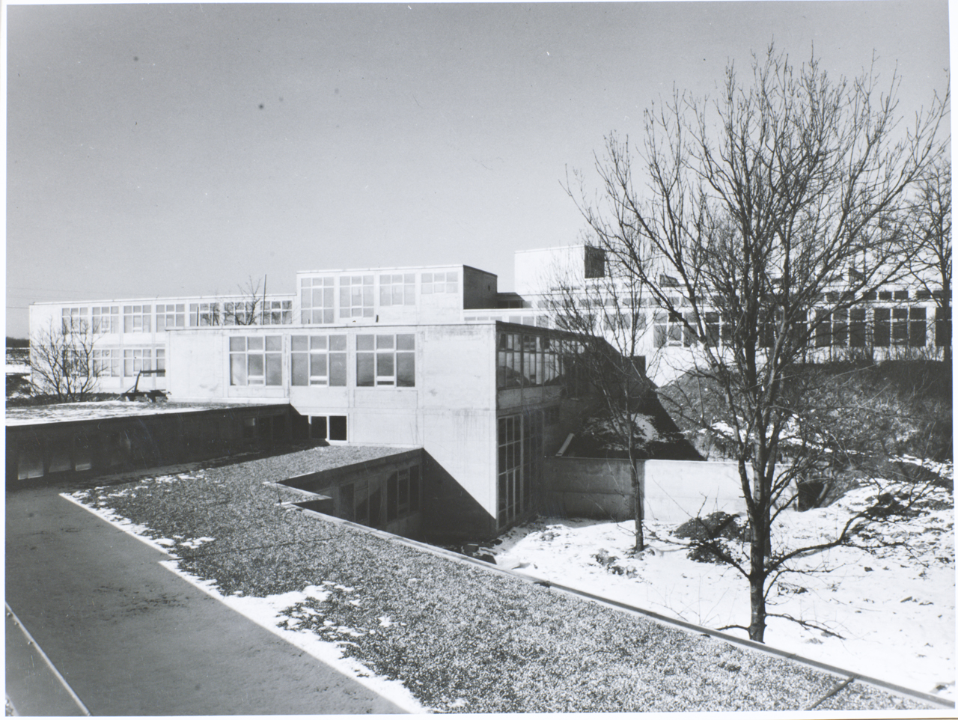
Ulm School of Design
The Ulm School of Design (German: Hochschule für Gestaltung Ulm) was a college of design based in Ulm, Germany. It was founded in 1953 by Inge Aicher-Scholl, Otl Aicher and Max Bill, the latter being first rector of the school and a former student at the Bauhaus. The HfG quickly gained international recognition by emphasizing the holistic, multidisciplinary context of design beyond the Bauhaus approach of integrating art, craft and technology.

Slide 5
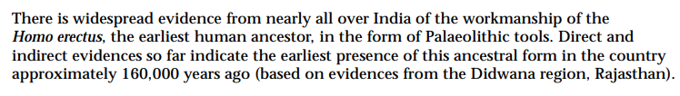
https://whc.unesco.org/uploads/nominations/925.pdf

Slide 6
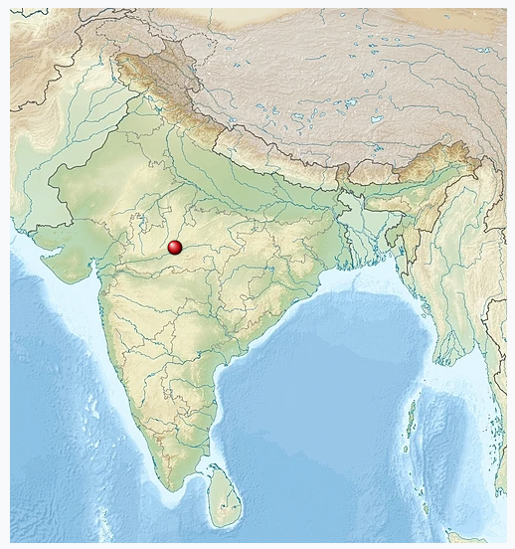
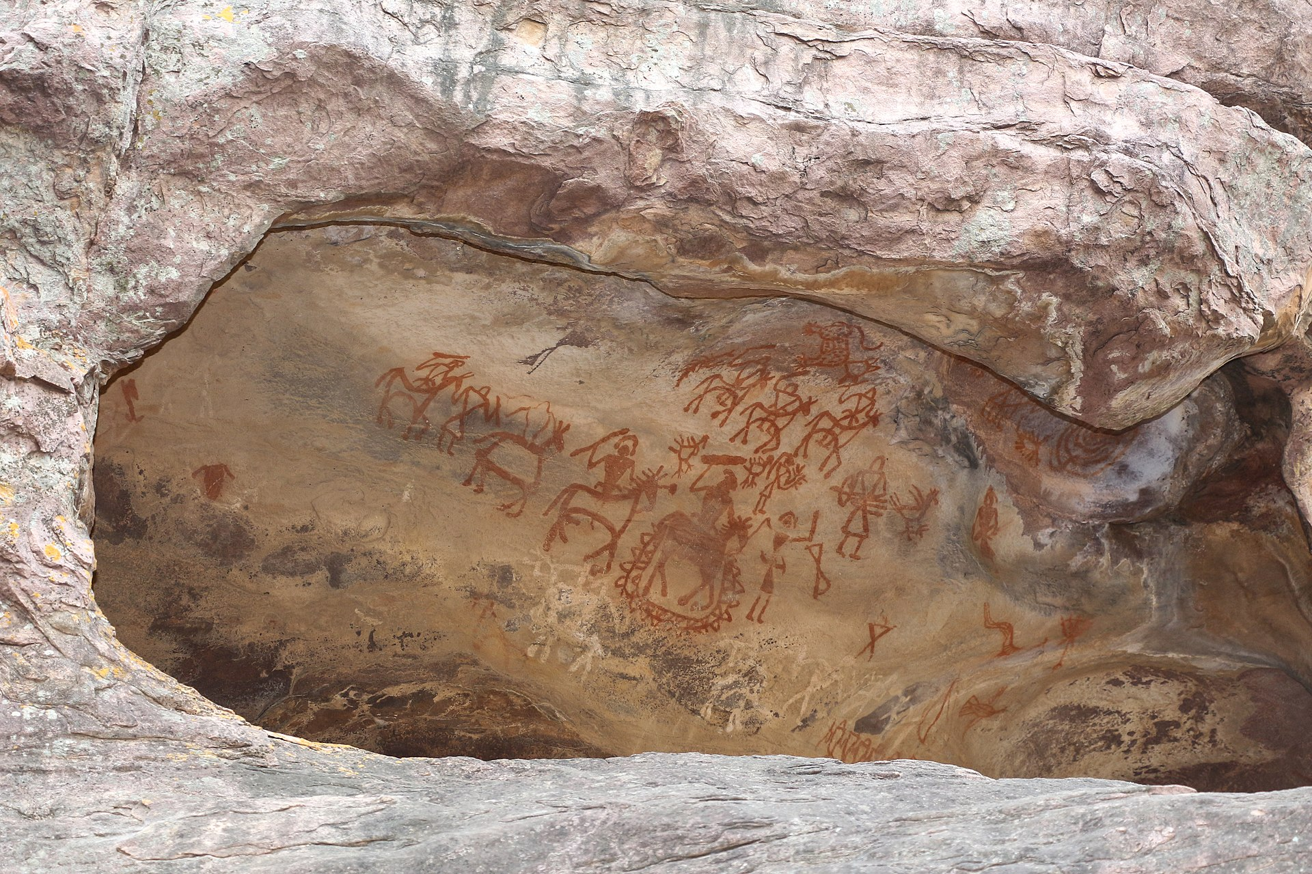
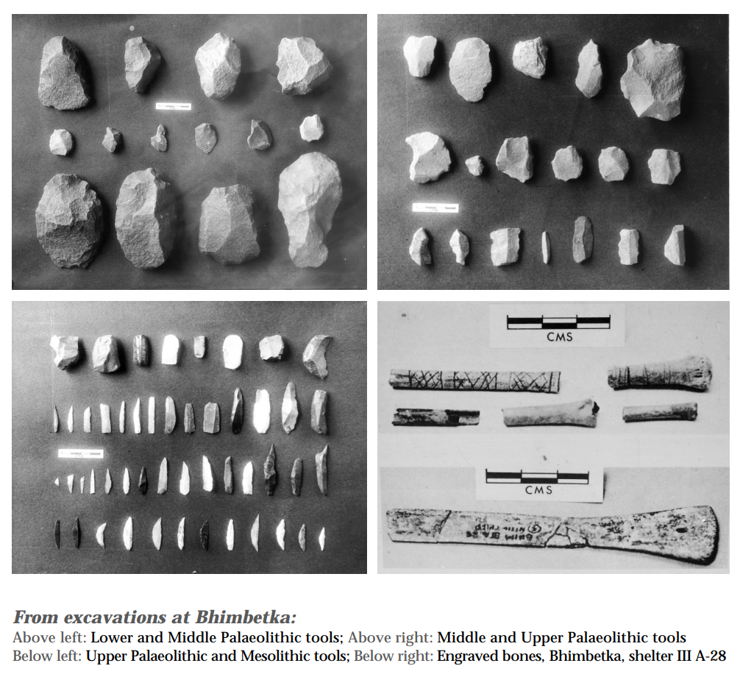
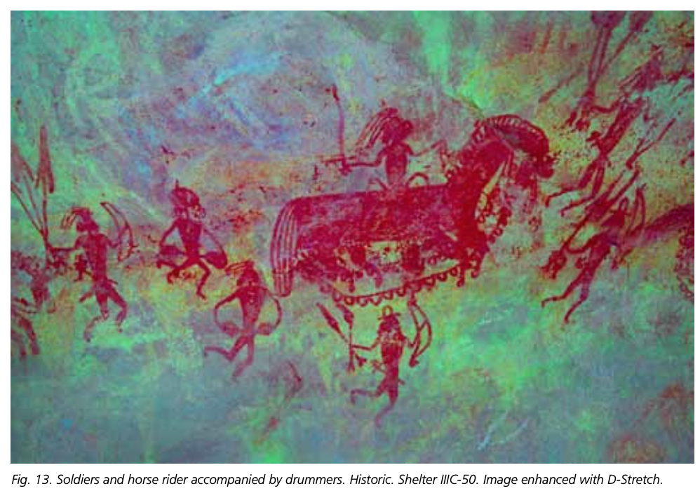
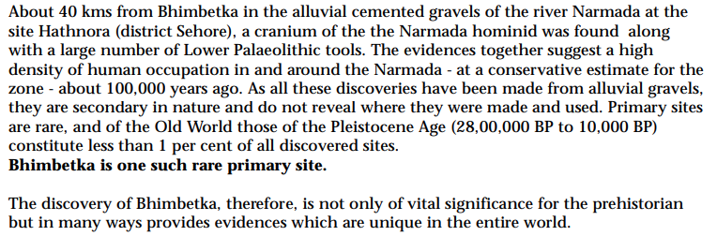
Bhimbetka Rock Shelters,
Madhya Pradesh
Discovered by:
VS Wakankar in 1957
“It exhibits the earliest traces of human life in India and evidence of the Stone Age …”

Slide 7
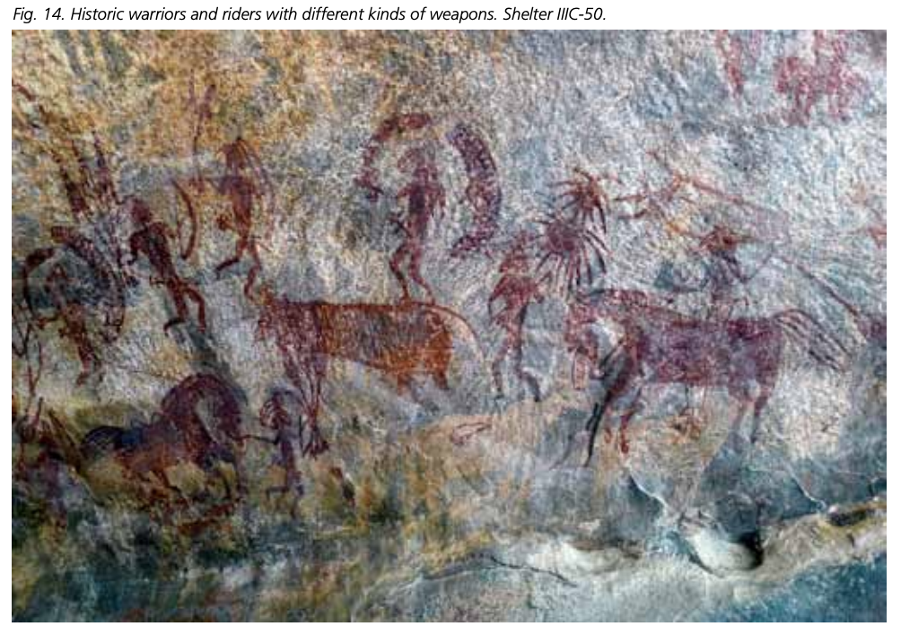
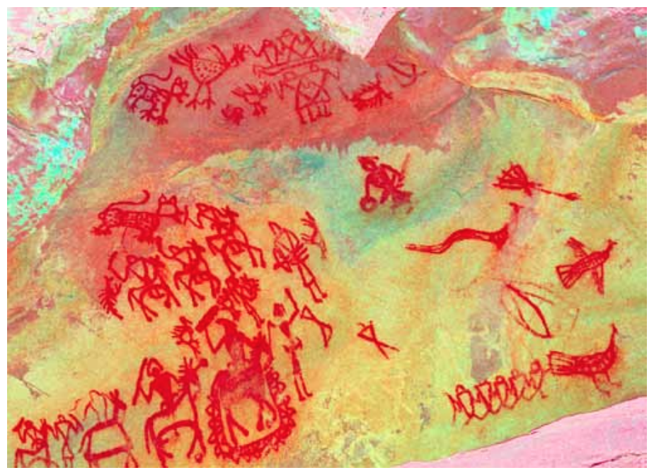
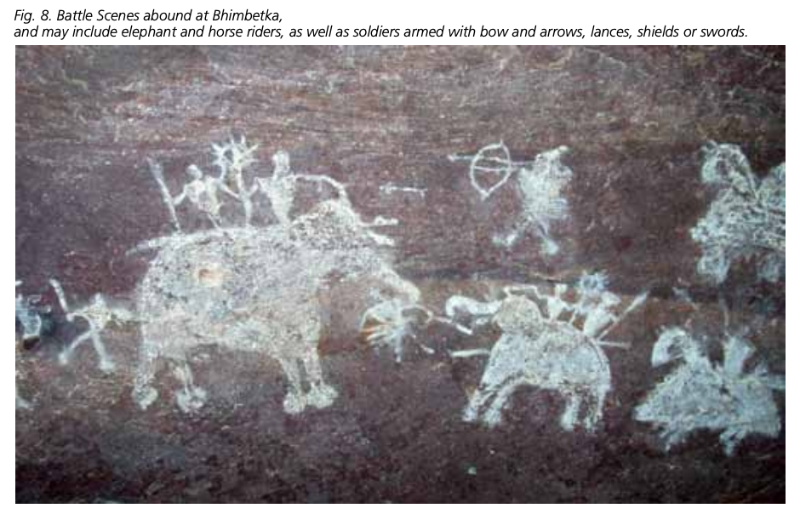
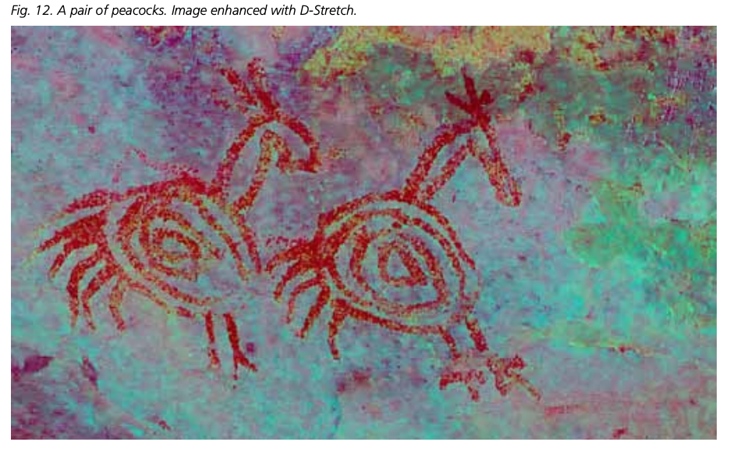
Notes:
The Bhimbetka rock paintings have been divided into three main styles. Each was then subdivided into 12 sub-styles by Wakankar and then by Mathpal. 1. Representational or Naturalistic approach: silhouetted, decorative, partially filled, outlined natural styles (Fig. 22). 2. Geometric approach: silhouetted, decorative, partially filled, outlined geometric styles (Fig. 10). 3. Abstract approach: silhouetted, decorative, partially filled, outlined styles. At Bhimbetka, drawings of representational (2116 images, 34.03%) and abstract styles (2392 images, 38.49%) are more common than in the geometric style (1558 images, 25.07%). Out of 6066 images (excluding 56 inscriptions and 92 indeterminate drawings), 3487 (56.09%) images are silhouetted, 1684 (27.10%) are outlined drawings and the remaining 895 (14.40%) are semi silhouetted and partially decorated (Mathpal 1984).

Slide 8
Bhimbetka Rock Shelters,
Madhya Pradesh
Discovered by:
VS Wakankar in 1957
Does it indicate the beginnings of Graphic Design?
“It exhibits the earliest traces of human life in India and evidence of the Stone Age …”

Slide 9
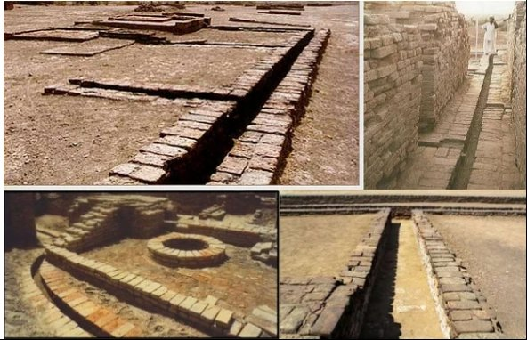
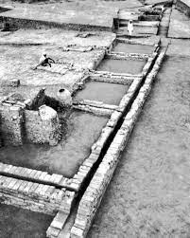
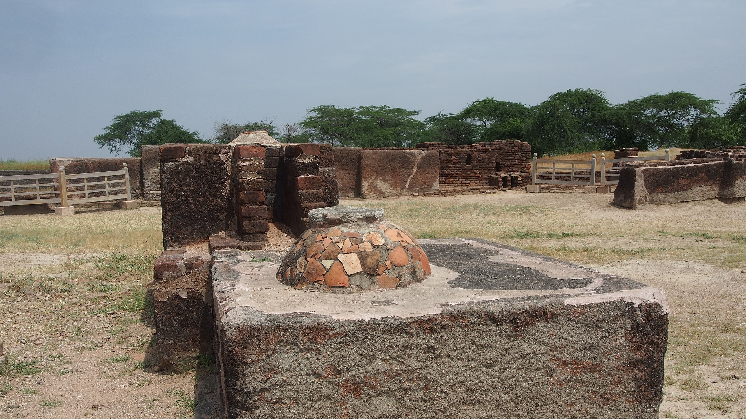
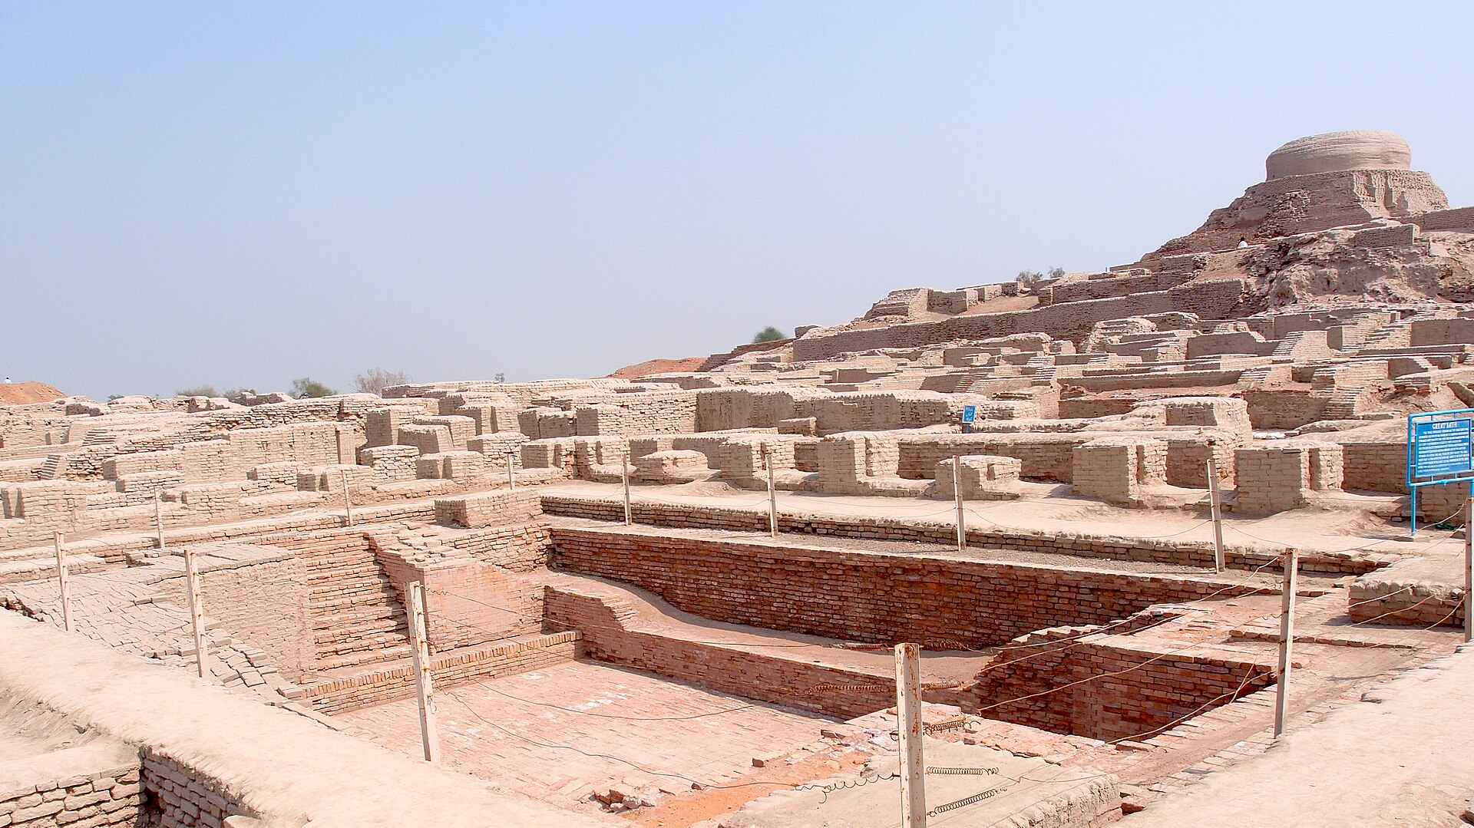
The Indus Valley Civilization (c. 3300–1300 BCE), one of the world’s earliest urban cultures, displayed remarkable design ingenuity in what is now north-western India and parts of modern-day Pakistan. Its cities, such as Harappa and Mohenjo-daro, were laid out on meticulously planned grids, showcasing an advanced understanding of urban design and civil engineering. Their sophisticated drainage systems, standardized weights and measures, and robust brick construction reflect a culture deeply attuned to functionality and precision. Intricately carved seals, figurines, and pottery further highlight the civilization’s artistic sensibilities. Collectively, these achievements underscore an enduring legacy of design principles—harmonizing utility, aesthetics, and social needs—that continued to influence the subcontinent’s cultural development.

Slide 10
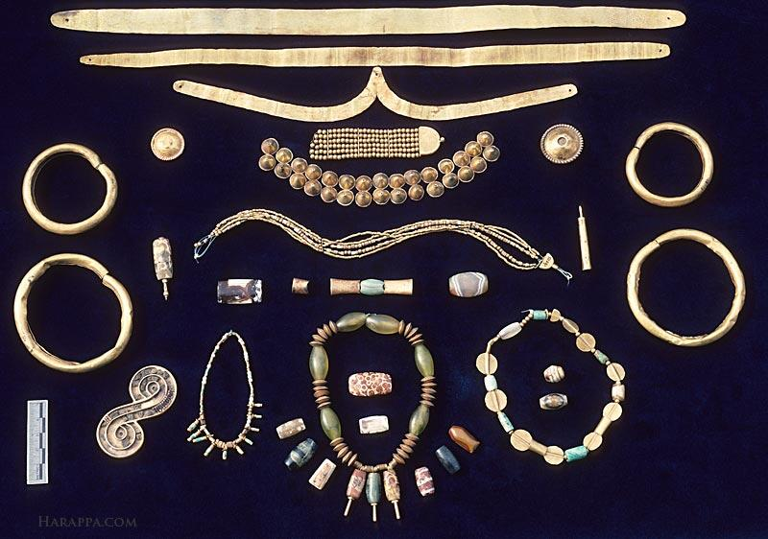
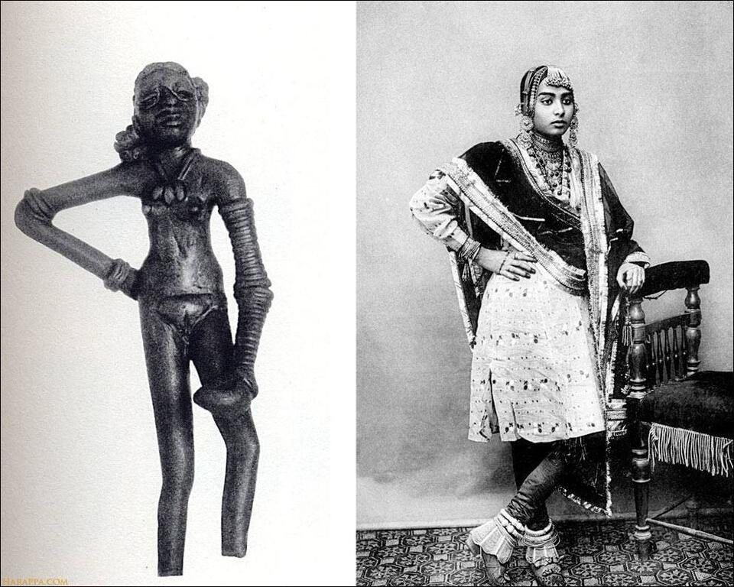
This collection of gold and agate ornaments includes objects found at both Mohen-jo-daro and Harappa. At the top are fillets of hammered gold that would have been worn around the forehead.
The Dancing Girl of Mohenjo-daro and a postcard of a Dancing Girl of Jaipur from 1905
https://jameelcentre.ashmolean.org/

Slide 11
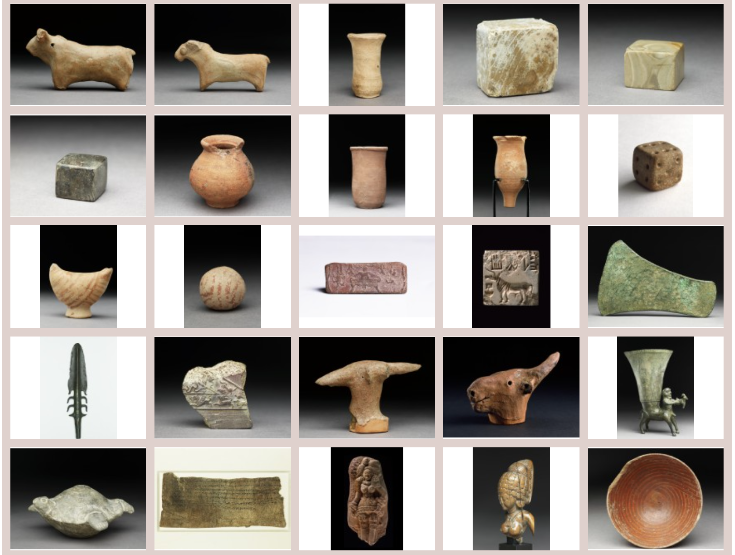
https://jameelcentre.ashmolean.org/

Slide 12
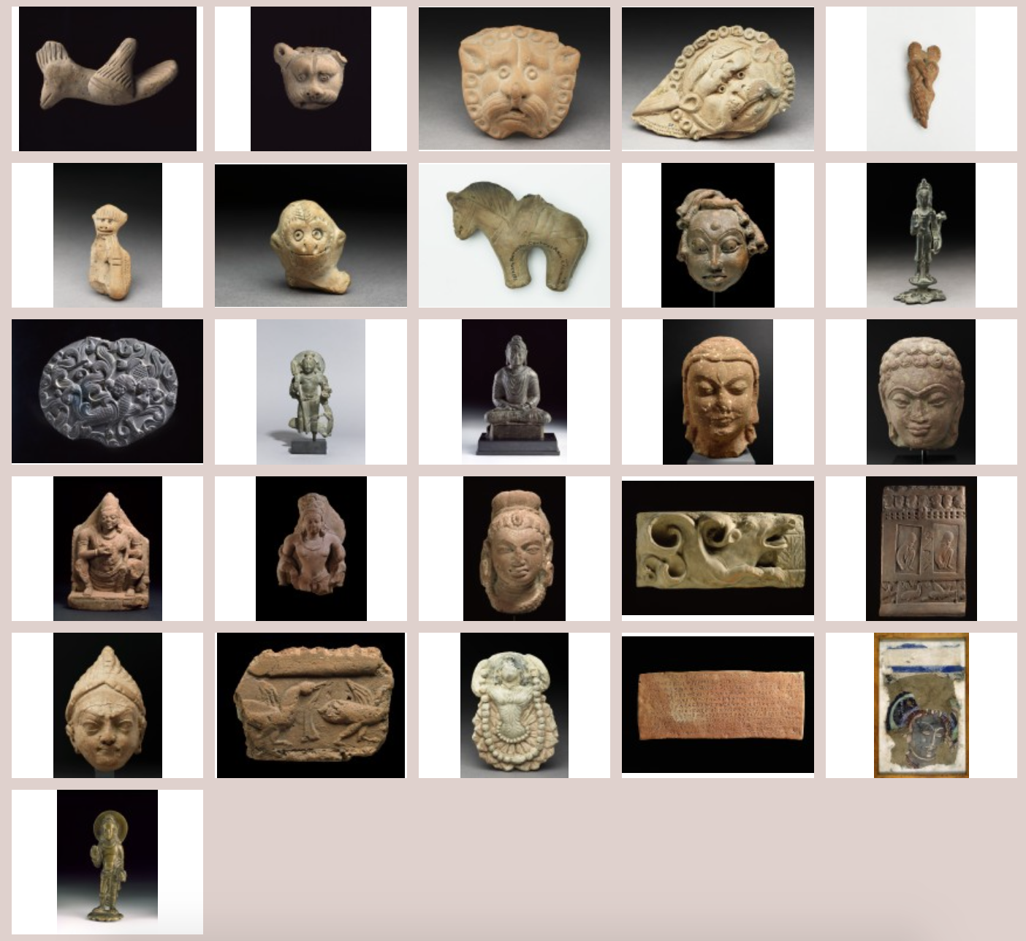
https://jameelcentre.ashmolean.org/

Slide 13
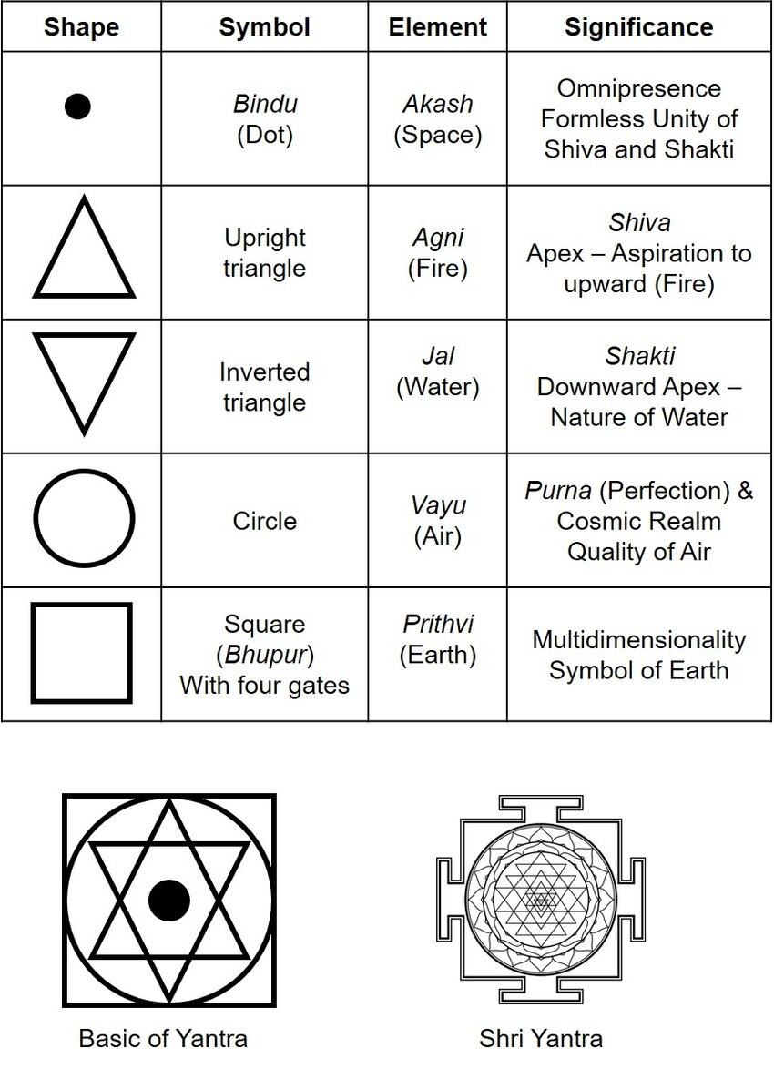
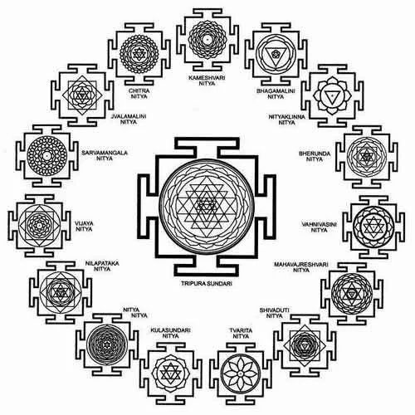
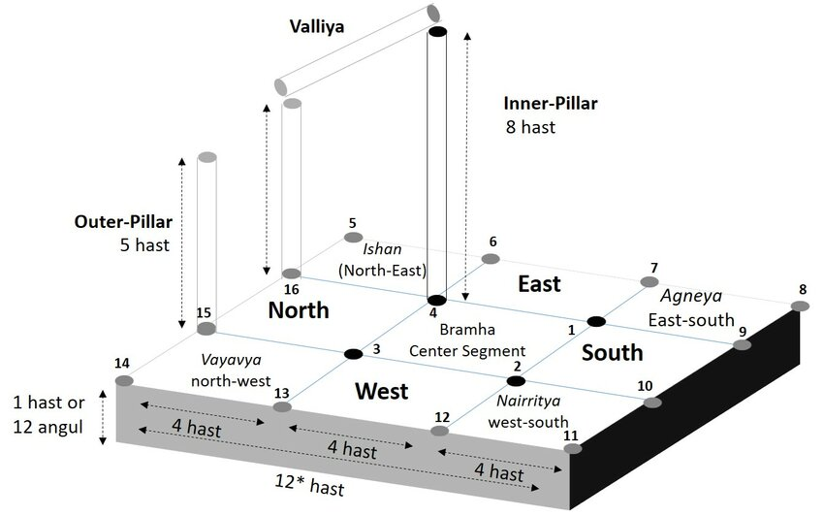
Iconography
Chandel, Ekta. "Mathematical and Scriptural Aspect of Yagya Mandap Construction." Interdisciplinary Journal of Yagya Research 5.1 (2022): 20-29.

Slide 14
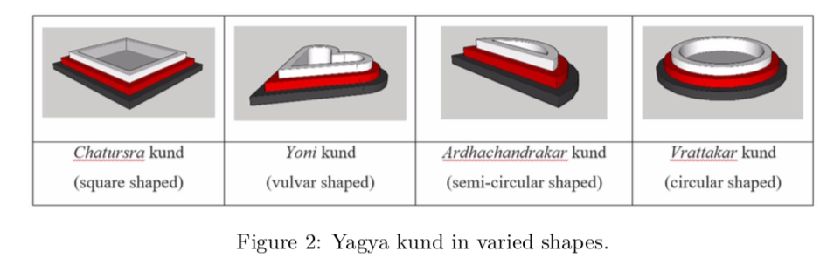
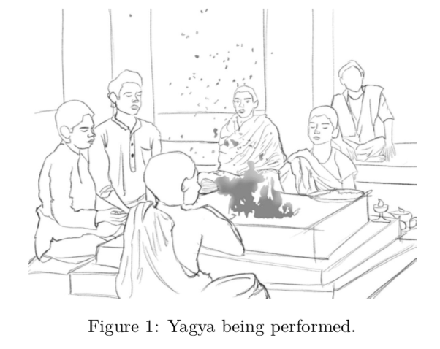
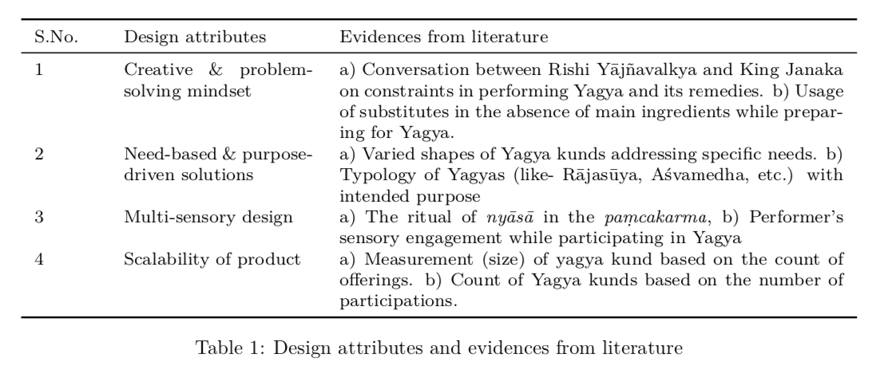
Srivastava, Abhishek, and Sonal Atreya. "Does the ancient Indian practice of Yagya reflect some critical product design attributes? A Designer’s perspective." Interdisciplinary Journal of Yagya Research 6.2 (2023): 12-20.

Slide 15
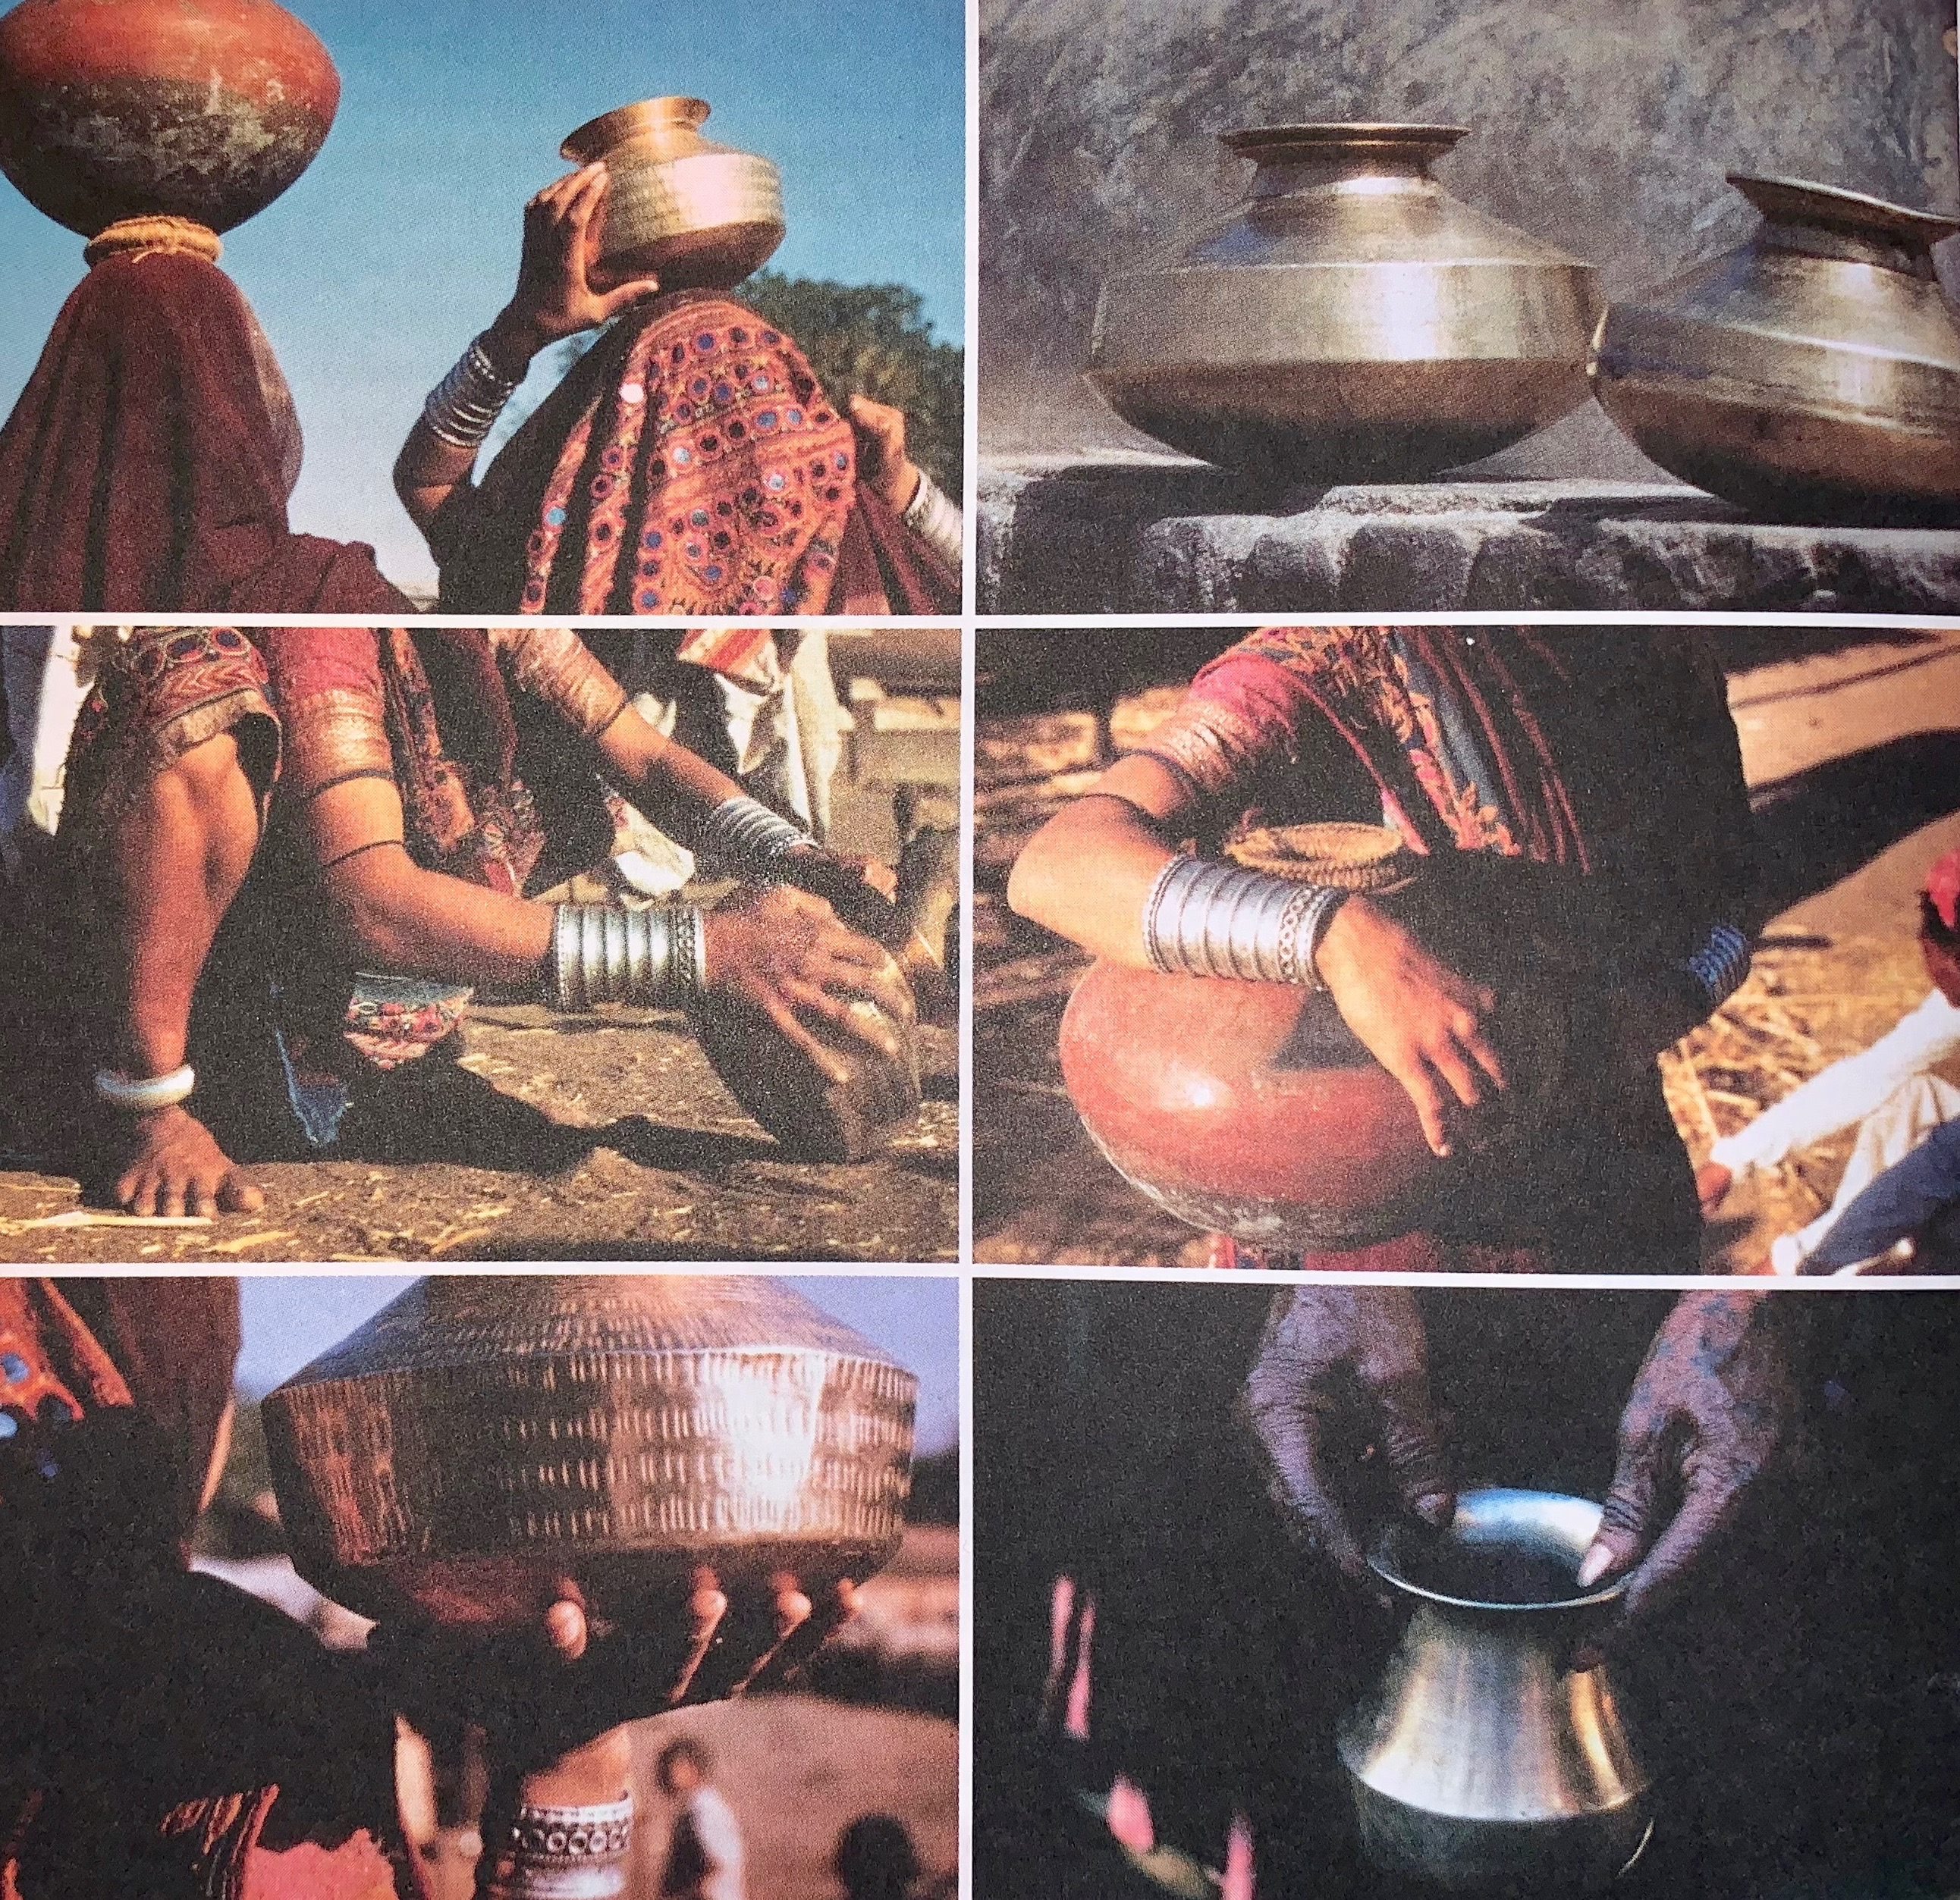
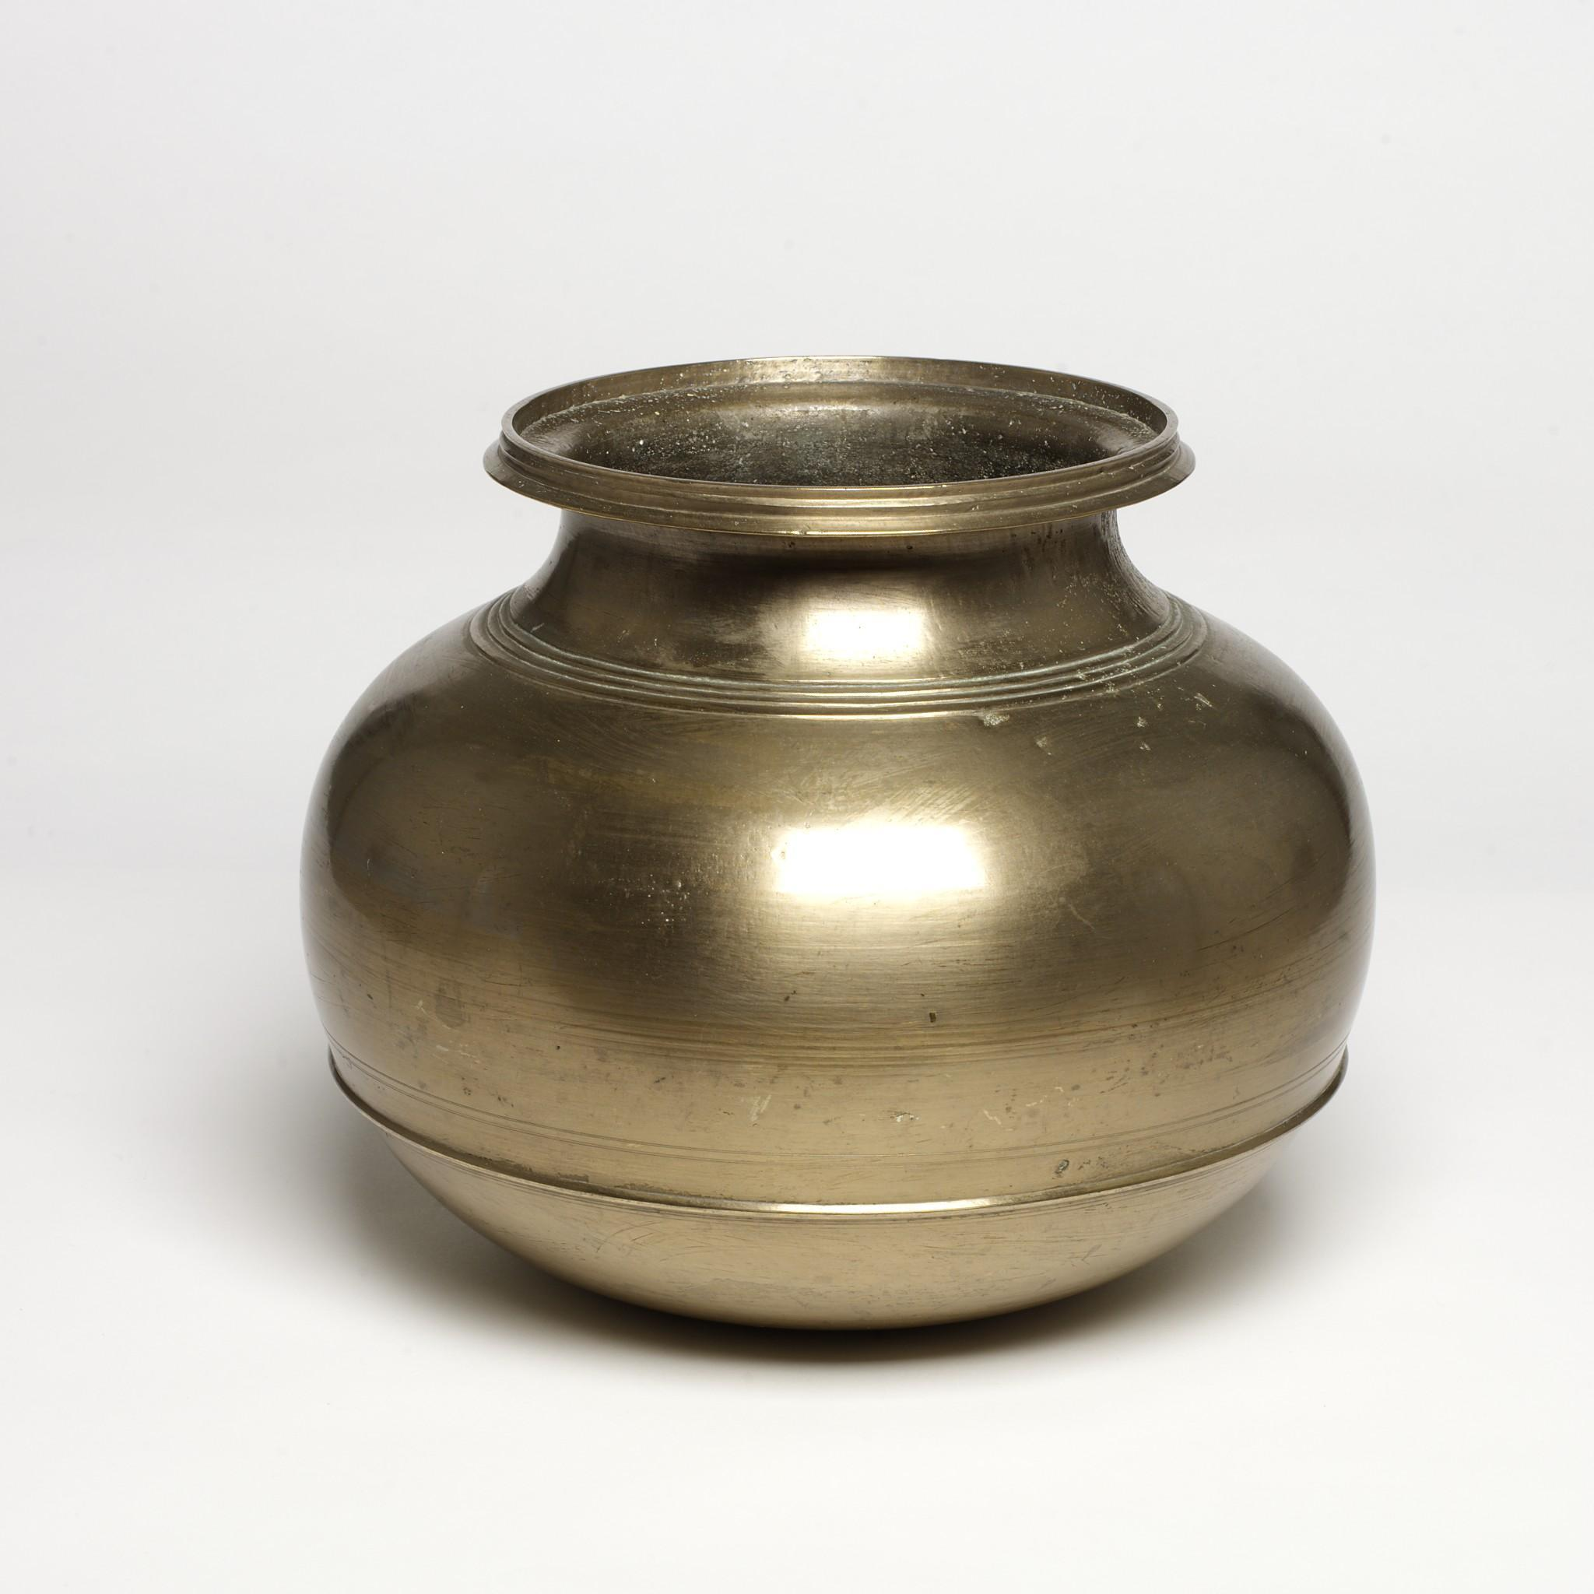

Slide 16
“A simple vessel of everyday use, stands out as perhaps the greatest, the most beautiful. (…) But how would one go about designing a lota? First, one would have to shut out all preconceived ideas on the subject and then begin to consider factor after factor:
The optimum amount of liquid to be fetched, carried, poured and stored in a prescribed set of circumstances.
The size and strength and gender of the hands (if hands) that would manipulate it.
The way it is to be transported: head, hip, hand, basket or cart.
The balance, the center of gravity, when empty, when full, its balance when rotated for pouring.
The fluid dynamics of the problem not only when pouring but when filling and cleaning, and under the complicated motions of head carrying—slow and fast.
Its sculpture as it fits the palm of the hand, the curve of the hip.
Its sculpture as complement to the rhythmic motion of walking or a static post at the well.
The relation of opening to volume in terms of storage uses—and objects other than liquid
The size of the opening and inner contour in terms of cleaning.
The texture inside and out in terms of cleaning and feeling.

Slide 17
Heat transfer—can it be grasped if the liquid is hot?
How pleasant does it feel, eyes closed, eyes open?
How pleasant does it sound, when it strikes another vessel, is set down on ground or stone, empty or full—or being poured into?
What is the possible material?
What is its cost in terms of working?
What is its cost in terms of ultimate service?
What kind of an investment does the material provide as product, as salvage?
“Of course, no one man could have possibly designed the lota. The number of combinations of factors to be considered gets to be astronomical—no one man designed the lota, but rather many men over many generations. Many individuals represented in their own way through something they may have added or may have removed or through some quality of which they were particularly aware.”

